Slide 1
Deep Q-Network
2021. 09. 16.
BCML

Slide 2
index
Reninfocement Learning
Q-table
Q function
Deep Q Networks

Slide 3
Reinfocement Learning
Reinforcement
Learing
Clustering
Classification
Machine
Learning
Supervised learning
Unsupervised learning
Transform
Regression
Association

Slide 4
Reinforcement Learning
Supervised Learning Learning
Reinforcement Learning Experience
+
-
+
+
-
Agent
Action
State
Enviornment
Reward
Policy

Slide 5
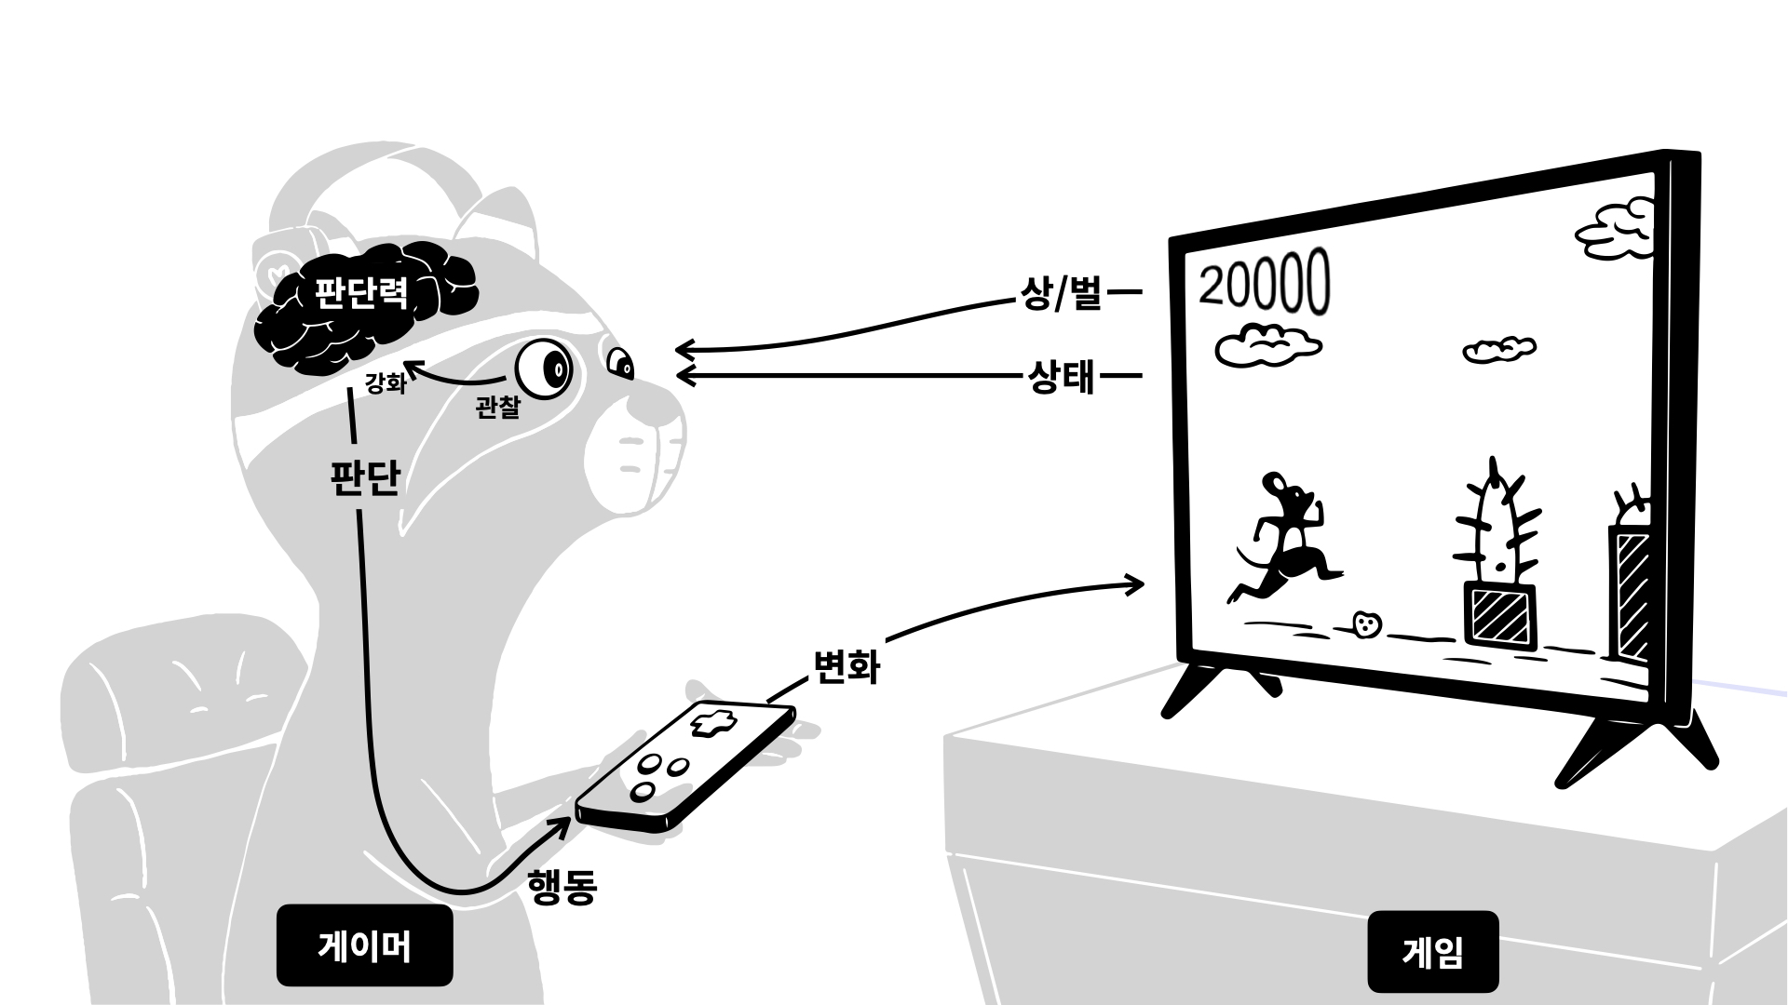
Reinforcement Learning

Slide 6
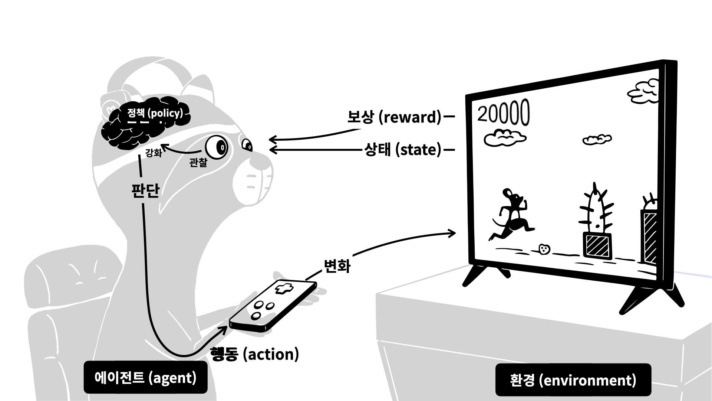
Reinforcement Learning

Slide 7
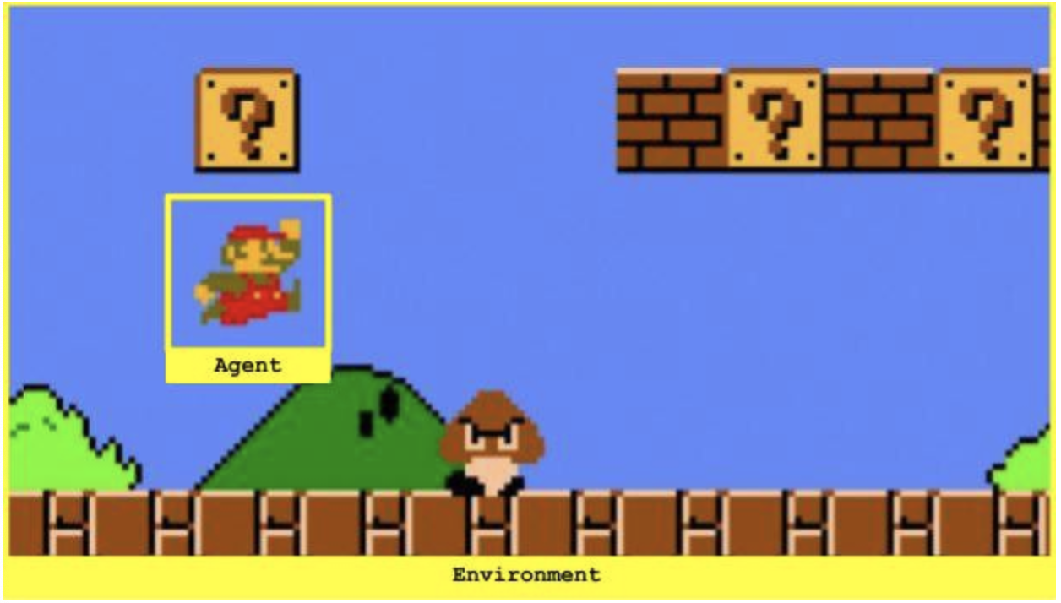
Reinforcement Learning(policy)
The decision-making strategy that agents will develop in the process of learning is called policy
Agent goal is to maximize the compensation value(+,-)
Delayed compensation

Slide 8
Q-tabel
0
0
 |  |  | 1
0
0
1
0
0
0
1
0
0
0
0
0
0
0
1
0
0
0
0
0
0
0
0
1
0
0
0
0
0
0
0
0
0
0
1
0
0
0
1
0
0
0
0
0
1
0
0
1
0
0

Slide 9
Q function
Q(s,a)=r(s,a)+γmaxaQ(s′,a)
Qπ(s,a)def=Eπ[Gt|St=s,At=a]

Slide 11
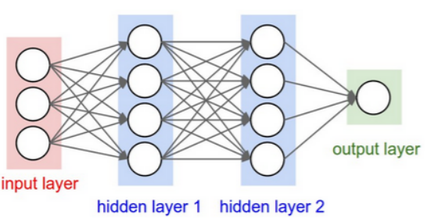
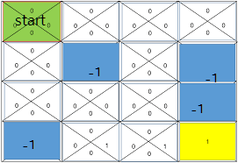
dqn

Slide 12
DQN's three solutions
1. Go deep
2. Capture and replay
Correlations between samples
3. Separate networks: create a target network
Non-stationary targets

Slide 13
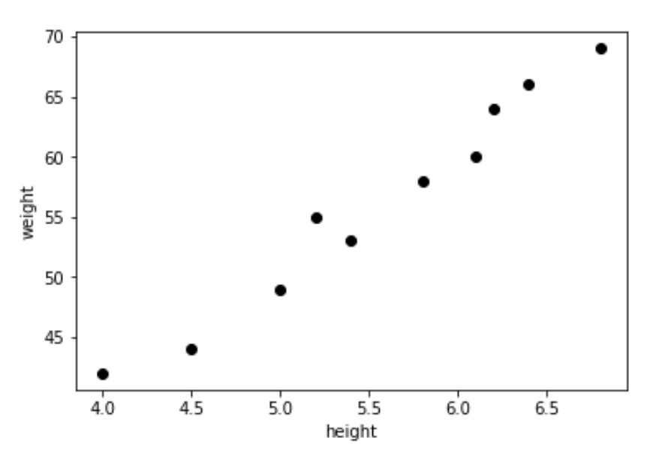
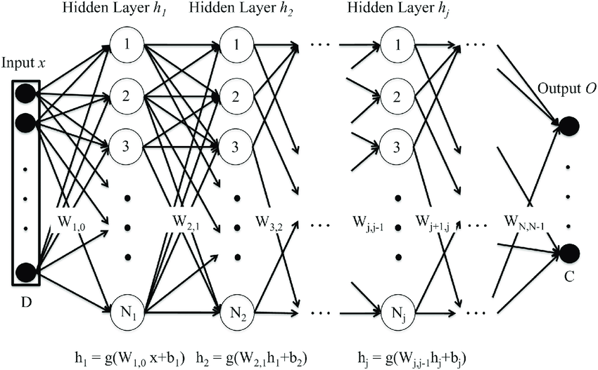
dqn

Slide 14
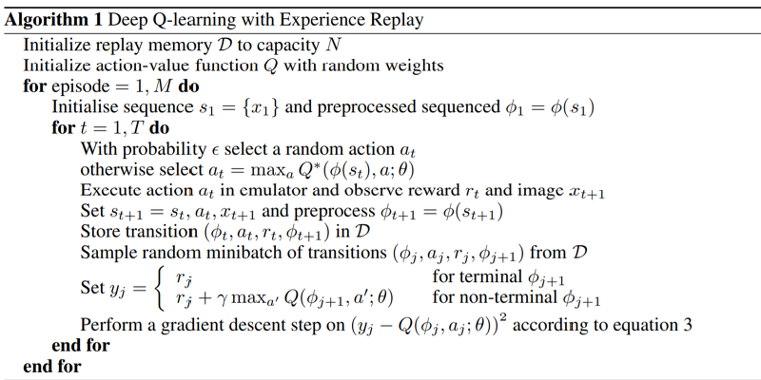
DQN algorithm

Slide 15
Thank you!
Q&A

